Slide 1

Fall 2019 DSE 203 Final Project
Erik Hoye, Bryan Cook, Arlens Zeqollari, Adita Zeqollari
Notes:
1 min

Slide 2
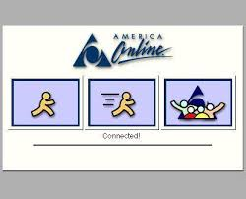
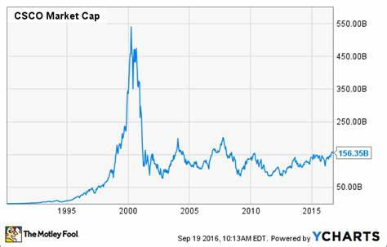

Once Upon a Time...
Notes:
1 min

Slide 3
Introduction
Worldwide leader in IT, networking, and cybersecurity solutions
Founded in December 1984 by Leonard Bosack and Sandy Lerner, two Stanford University computer scientists
The name "Cisco" was derived from the city name San Francisco.
The logo is intended to depict the two towers of the Golden Gate Bridge.
Notes:
1 min

Slide 4
Why We Chose Cisco...
Rich data:
Over 200 acquisitions in the last 30+ years
Multiple competitors
Diverse services and products
Everything else was already taken
Notes:
1 min

Slide 5








Data Sources
Notes:
1 min

Slide 6
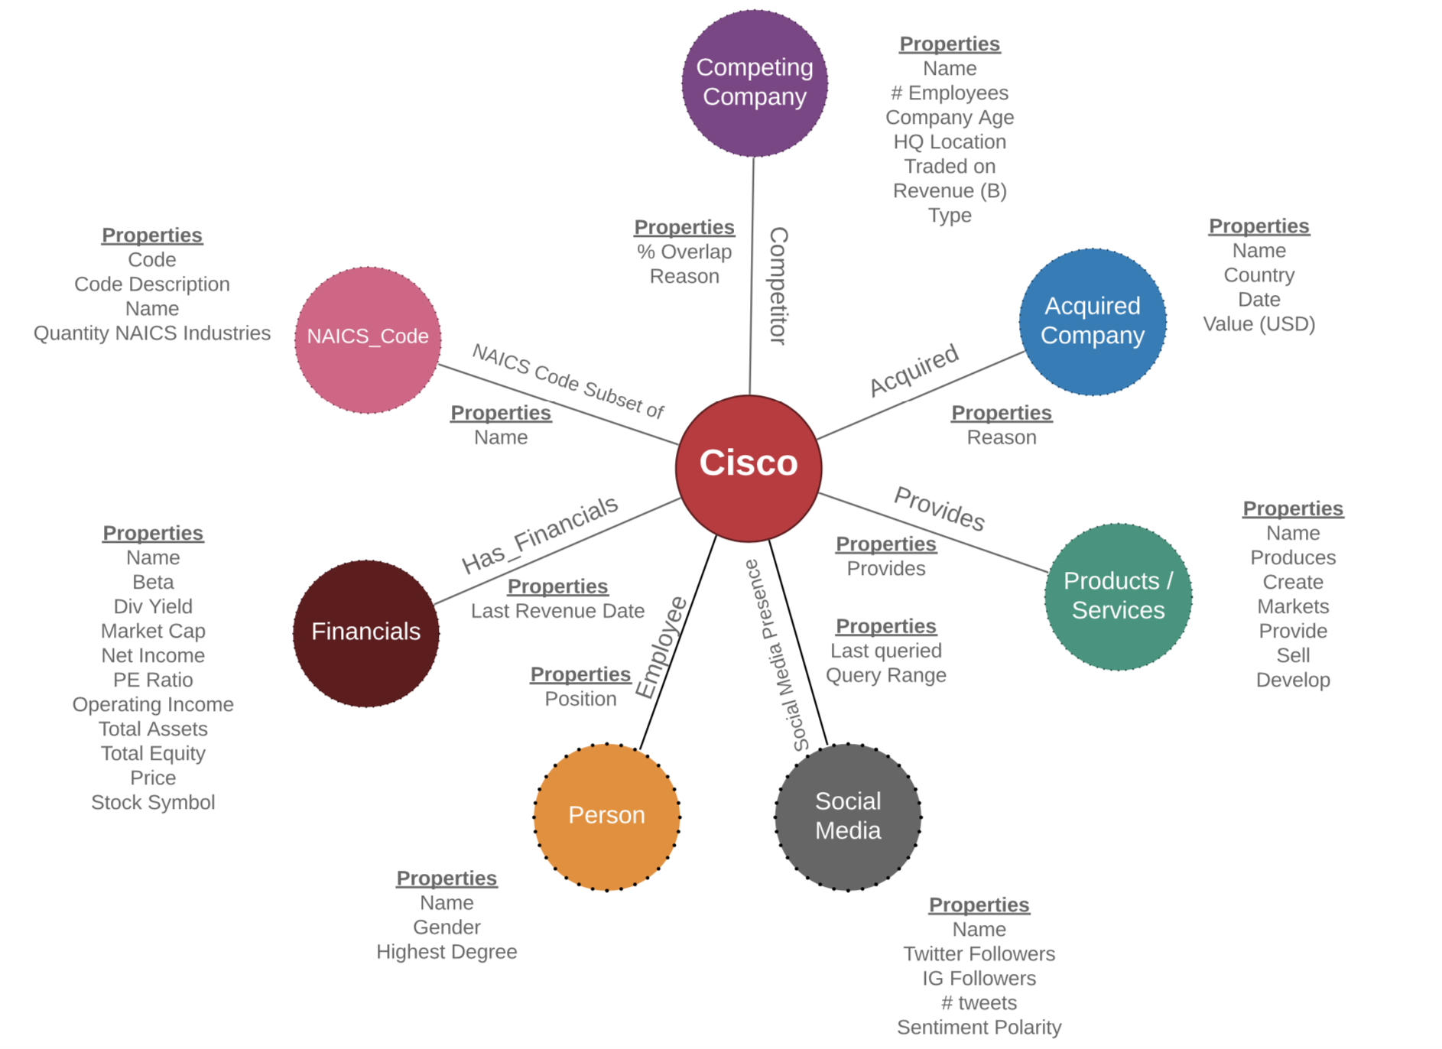
Generalized Structure
Notes:
1 min

Slide 7
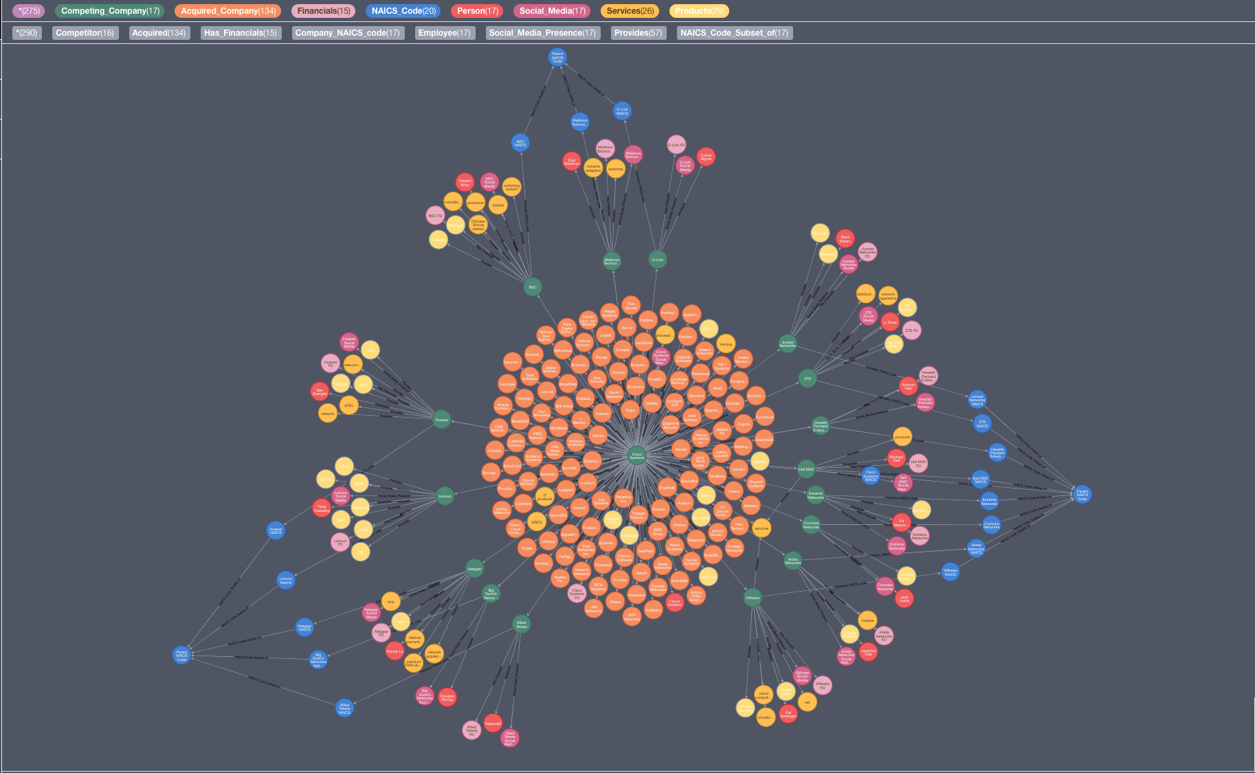
o
Notes:
1 min

Slide 8


















Competing Companies from
Notes:
2 min

Slide 9
Competing Company Nodes
Edge Properties
% overlap
Reason (product)
Node Properties
Name
# Employees
HQ location
Company Age
Financial Type
Traded On (e.g. NASDAQ)
Number of founders
Revenue
Notes:
1 min

Slide 10


Person Nodes
Node Properties
Name
Highest Degree
Gender
Edge Properties
Position
Notes:
1 min

Slide 11
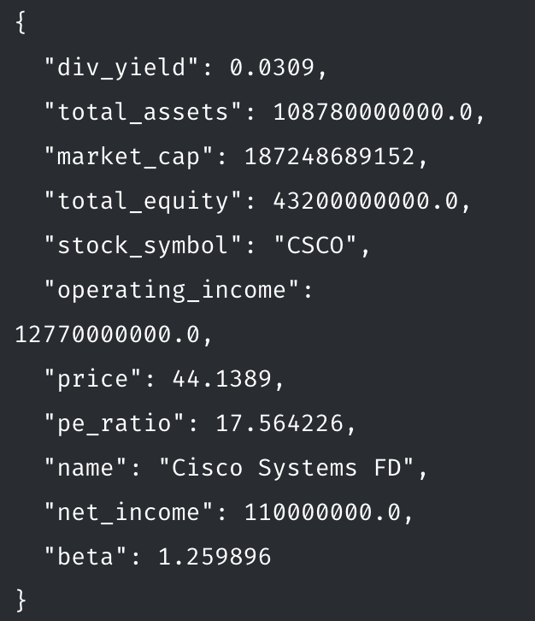





Financials Nodes
Utilized Yahoo! Finance API to query up-to date financial data for each company.
Notes:
1 min

Slide 12
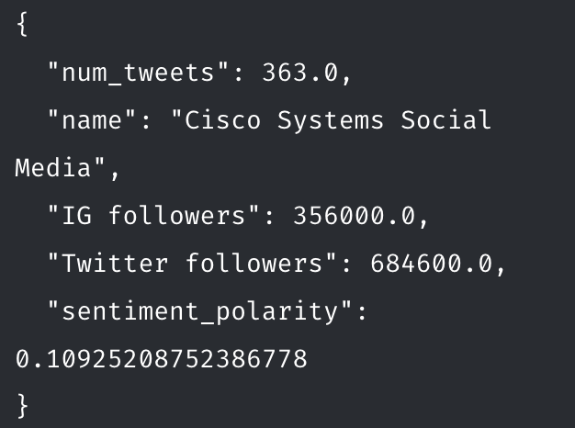


Social Media & Sentiment Analysis Nodes
Utilized Vicinitas.io to gather up to 2000 tweets for Cisco and each competitor company over a 10-day range.
Used TextBlob sentiment analysis on these tweets and averaged polarity.
Number of followers was obtained manually from Twitter / Instagram.
Notes:
1 min

Slide 13


NAICS Code Nodes
Data was was scraped using Selenium
Required some modification due to https://siccode.com search engine not being very good
Utilized the parent codes as well as company codes to identify groupings for competing companies
Demonstrated how dynamic Cisco is as a company
Notes:
1 min

Slide 14
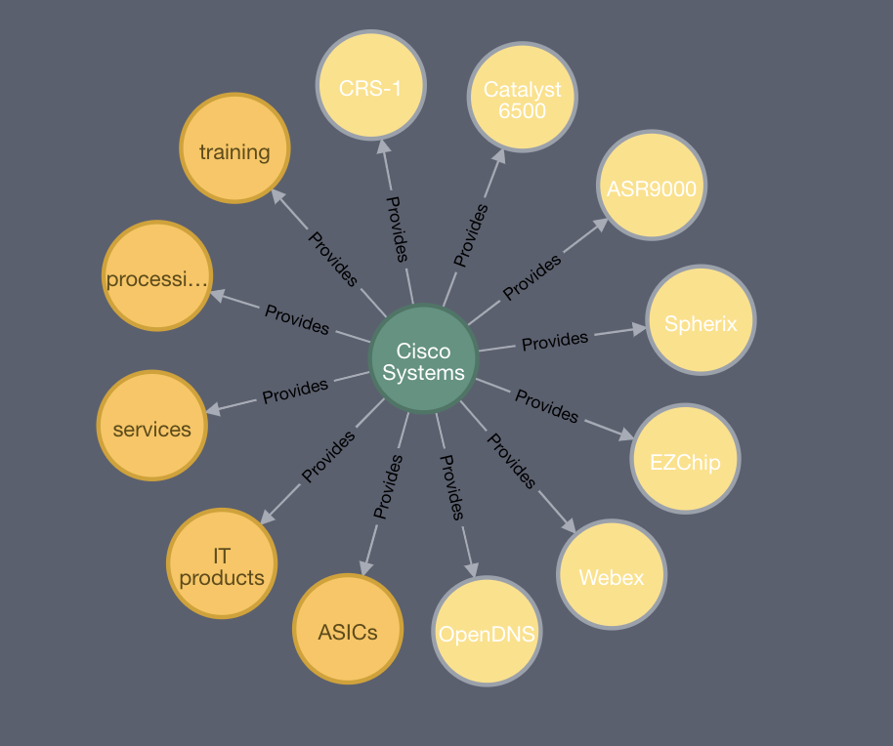

Products / Services Nodes
All Data was acquired by scraping text from Wikipedia
Used neuralcoref with spaCy for coreference clustering to identify all relations to our company nodes
Combined the clusters with subject_verb_object_triples to identify services that companies provided
Utilized spaCy entity labeling to identify products produced by the company
Notes:
1 min

Slide 15
Interesting Queries...

Slide 16
As a Reminder
o
Notes:
1 min

Slide 17
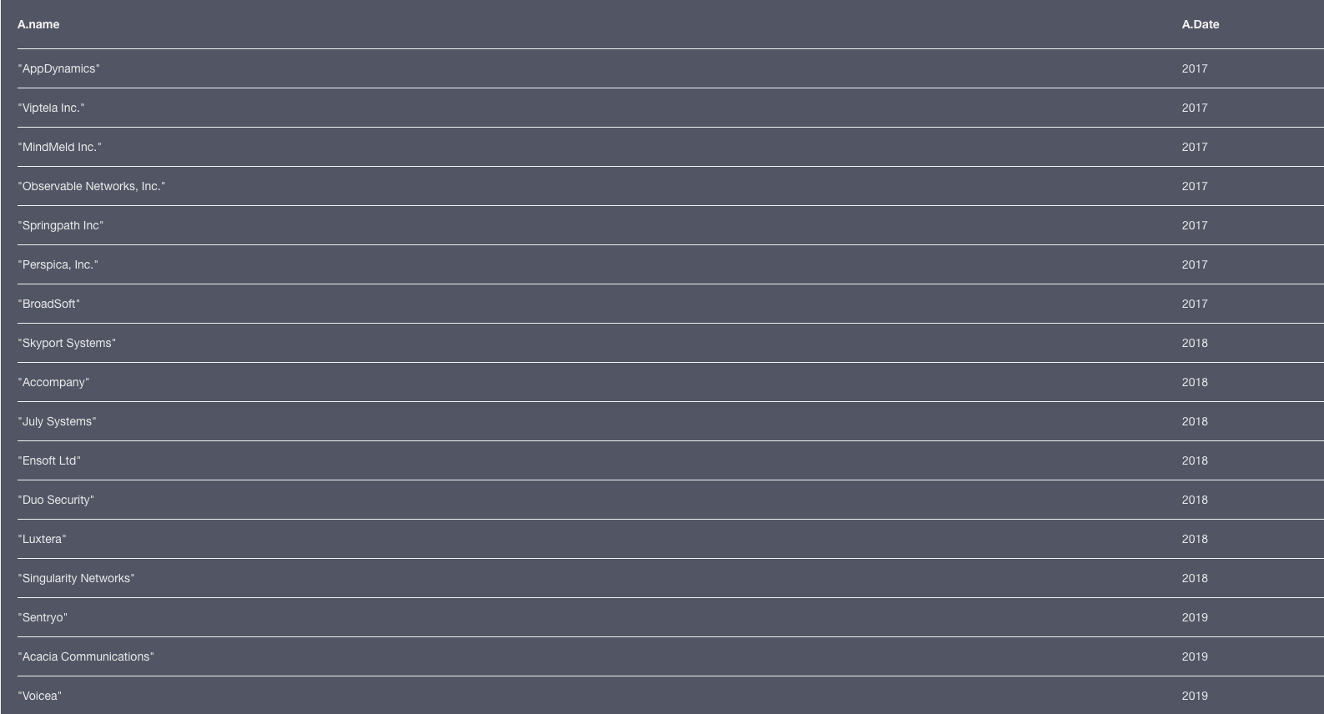
Q: Who has Cisco acquired in the last 3 years?
MATCH (A:Acquired_Company) WHERE A.Date > 2016
RETURN A
Notes:
1 min

Slide 18
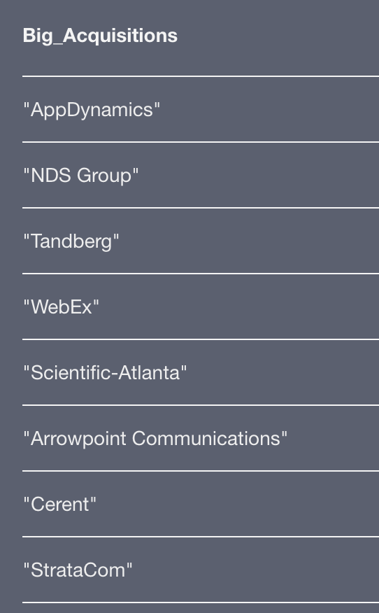
Money, money, money
Q: What large acquisitions (greater than $3B) has Cisco made?
MATCH (:Competing_Company {name: "Cisco Systems"})-[:Acquired]->(a:Acquired_Company)
WHERE a.`Value (USD)` > 3000000000
RETURN a.name AS Big_Acquisitions
Notes:
1 min

Slide 19
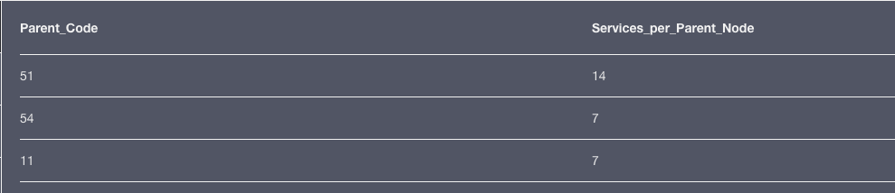
Identify Company Groupings
Q: For each 2 digit Parent code for NAICS codes, what is the total number of services provided by the companies linked to them?
MATCH (N:NAICS_Code)<-[: NAICS_Code_Subset_of]-(n)<-[: Company_NAICS_code]-(C: Competing_Company)-[: Provides]->(S: Services)
RETURN N.Code as Parent_Code, count(S) as Services_per_Parent_Node
Notes:
1 min

Slide 20

Diversity in Tech
Q: How many CEOs of competing companies are female & have Masters level education or greater?
MATCH (:Competing_Company)-[e:Employee]->(p:Person)
WHERE p.Gender = "Female"
AND ("MBA" in p.`Highest Degree` OR "M.S." in p.`Highest Degree`)
RETURN p.name as CEO, p.`Highest Degree` as Highest_Degree
Notes:
1 min

Slide 21
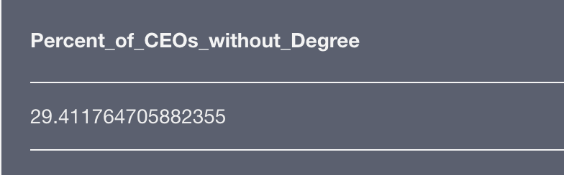
Overachieving Dropouts
Q: What percentage of CEOs of competing companies do not have a college degree?
MATCH (:Competing_Company)-[e:Employee]->(p:Person)
WHERE p.`Highest Degree` = "None" WITH toFloat(count(p)) AS N_count
MATCH (:Competing_Company)-[e:Employee]->(p:Person)
RETURN N_count/toFloat(count(p))*100 as Percent_of_CEOs_without_Degree
Notes:
1 min

Slide 22
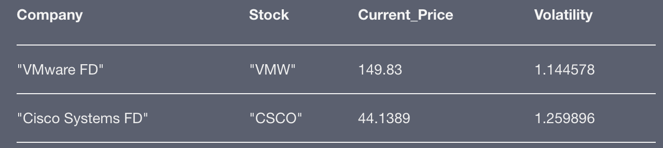
Stock Advice*
Q: As a money manager designing a risk-averse portfolio, which public companies have relatively low price/earning ratio, high operating income, mid-to-large market capitalization, and relatively low volatility (beta)?
MATCH (c:Competing_Company)-[:Has_Financials]->(f:Financials)
WHERE exists(f.stock_symbol)
AND f.operating_income > 500000000 AND f.market_cap > 1000000000 AND f.pe_ratio < 20 AND f.beta < 1.3
RETURN f.name as Company, f.stock_symbol as Stock, f.price as Current_Price, f.beta as Volatility
ORDER BY Volatility
*Past performance is not necessarily indicative of future results. All investments carry risk and all investment decisions of an individual remain the responsibility of that individual. There is no guarantee that systems, indicators, or signals will result in profits or that they will not result in losses. All investors are advised to fully understand all risks associated with any kind of investing they choose to do.
Notes:
1 min

Slide 23
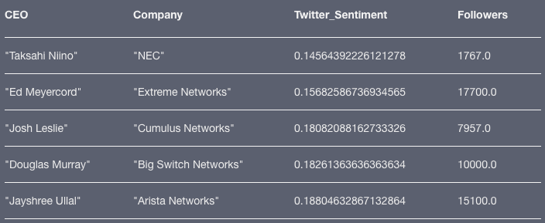
Social Media Consulting
Q: Which CEOs have done the worst job in ensuring their company has a substantial online following (>20k followers) along with a positive sentiment in recent Twitter posts?
MATCH (p:Person)<-[:Employee]-(c:Competing_Company)-[:Social_Media_Presence]->(s:Social_Media)
WHERE s.sentiment_polarity < 0.2 AND s.`Twitter followers` < 20000
RETURN p.name as CEO, c.name as Company, s.sentiment_polarity as Twitter_Sentiment, s.`Twitter followers` as Followers
ORDER BY Twitter_Sentiment
Notes:
1 min

Slide 24
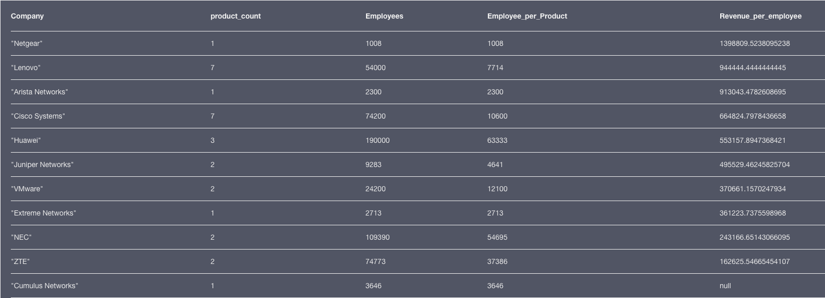
Key Performance Metrics
Q: Based on products extracted from Wikipedia text, which company is the leanest in terms of revenue per employee? Number of employees working on each product?
MATCH (c:Competing_Company)-[:Provides]->(p:Products) WITH c, c.`# Employees` as Employees, count(p) as product_count
WHERE product_count > 0 RETURN c.name as Company, product_count, Employees, (Employees/product_count) as Employee_per_Product, (c.`Revenue (B)` / Employees) as Revenue_per_employee
ORDER BY Revenue_per_employee DESC
Notes:
1 min

Slide 25
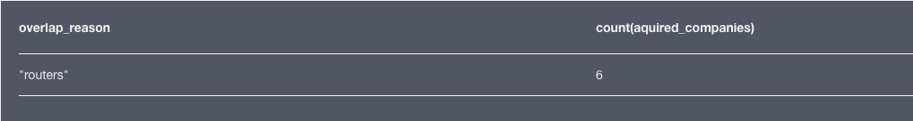
Grouping Acquisitions
Q: Is it possible to identify one of Cisco’s main businesses from our knowledge graph and find how many competing companies were acquired in this business?
MATCH ()-[c:Competitor]-() with max(c.`% Overlap`) as max_overlap
MATCH ()-[c:Competitor]-(company) WHERE c.`% Overlap` = max_overlap and not company.name ='Cisco Systems' with c.Reason as overlap_reason
MATCH ()-[c:Acquired]-(aquired_companies) WHERE c.Reason = overlap_reason RETURN overlap_reason, count(aquired_companies)
Notes:
1 min

Slide 26
Lessons Learned & Project Challenges
Choose your subject well! Cisco isn’t the “coolest” company, but there is a rich data set.
As expected, project organization and division of work is extremely efficient.
Web scraping is a great tool, but it’s not a panacea for complete data. Complete automation is very difficult.
When meeting the requirements, there was an interesting balance between creating the database vs. knowing which questions we want to ask.
Sparse data for acquired companies.
Accessing a richer set of Twitter data was difficult. We used Vicinitas.io which only allowed up to 2000 tweets in the last 10 days only.
Notes:
2 min

Slide 27
Potential Enhancements
Automate the data generation and run on a schedule to keep data up-to-date.
For products, develop method to classify product / product category.
Utilize a larger set of social media data and identify other characteristics.
Identify relevant tweets more appropriately (example: Tweets involving “NEC” is not always about the company, but about the Northeast Conference).
Add additional positions (CIO, CFO, etc) to People nodes.
Implement proliferative generation of nodes and node relationships.
Notes:
1 min

Slide 28
Questions?

